Slide 1
Improving Growth Mindset, Agency, and Help-Seeking through Self-Reflection
Ross Markle, Ph.d.
Founder, Managing Director
DIA Higher Education Collaborators
Notes:
Student self-reflection is a powerful tool for engaging students in their own success. Through a structured process of identifying strengths and challenges, considering available supports, and creating an action plan, self-reflection fosters key mindsets central to a strong first-year experience (e.g., agency, help-seeking, growth mindset, self-efficacy). Drawing on an example reflection exercise implemented at several institutions nationwide, this session will explore (a) how to design an effective self-reflection activity, (b) strategies for integrating reflection into existing FYE initiatives, and (c) additional ways to incorporate reflection and feedback to strengthen FYE efforts.

Slide 2
Reflection as an intervention

Slide 3

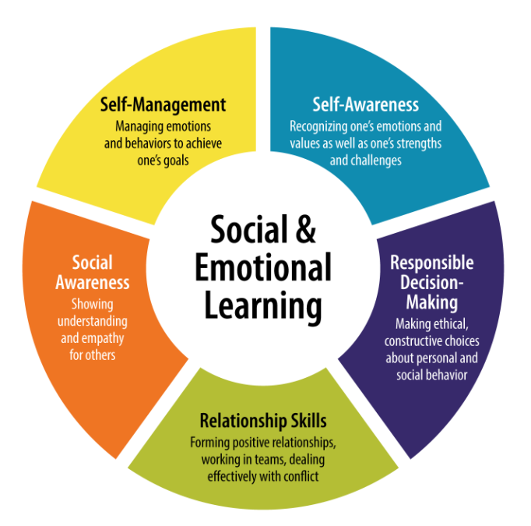
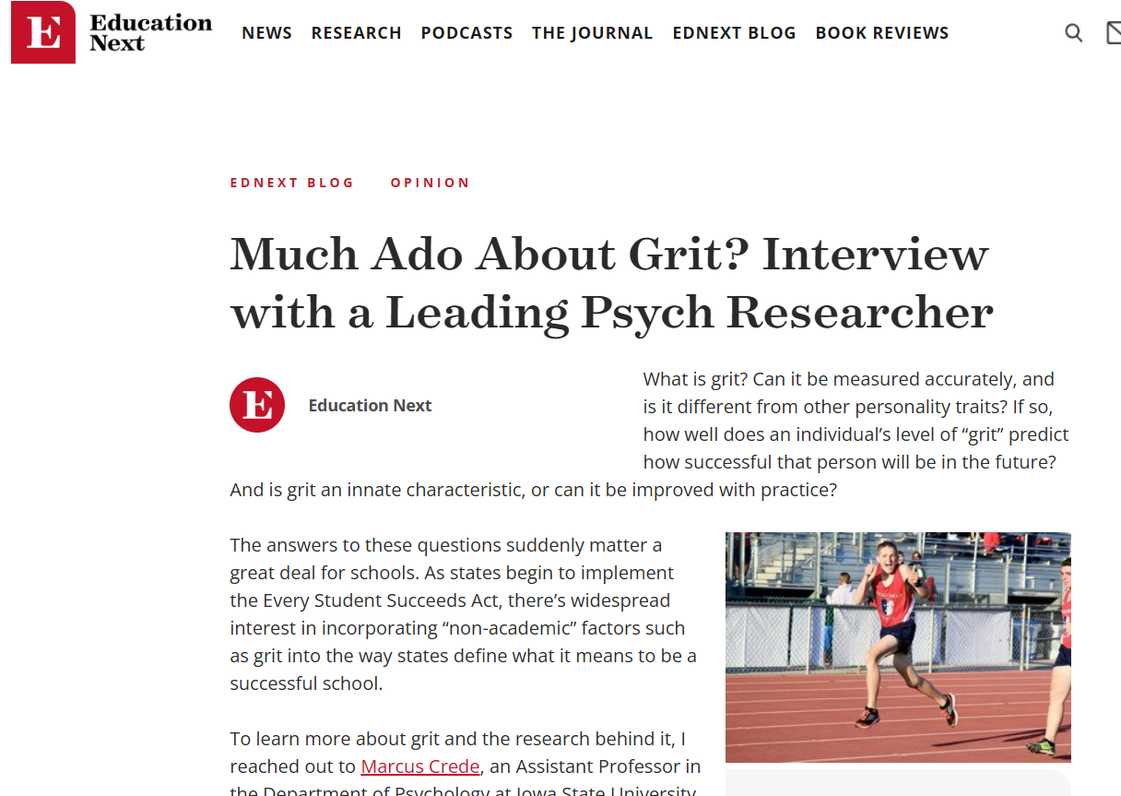
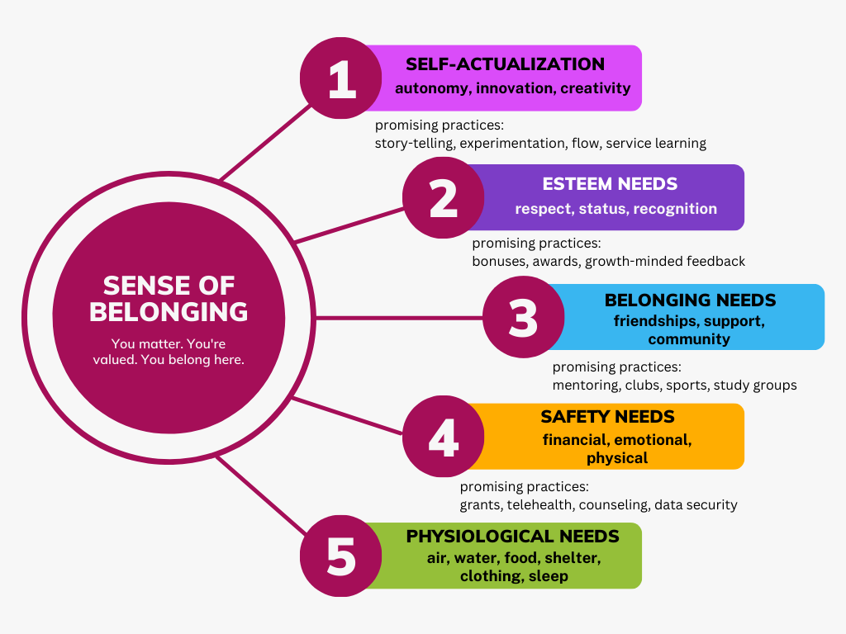
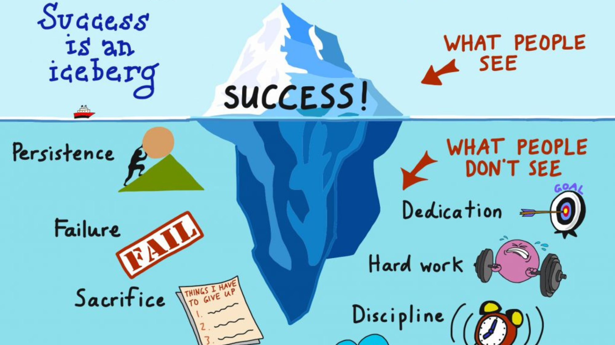
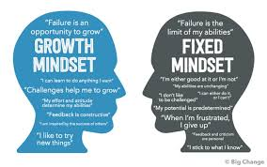
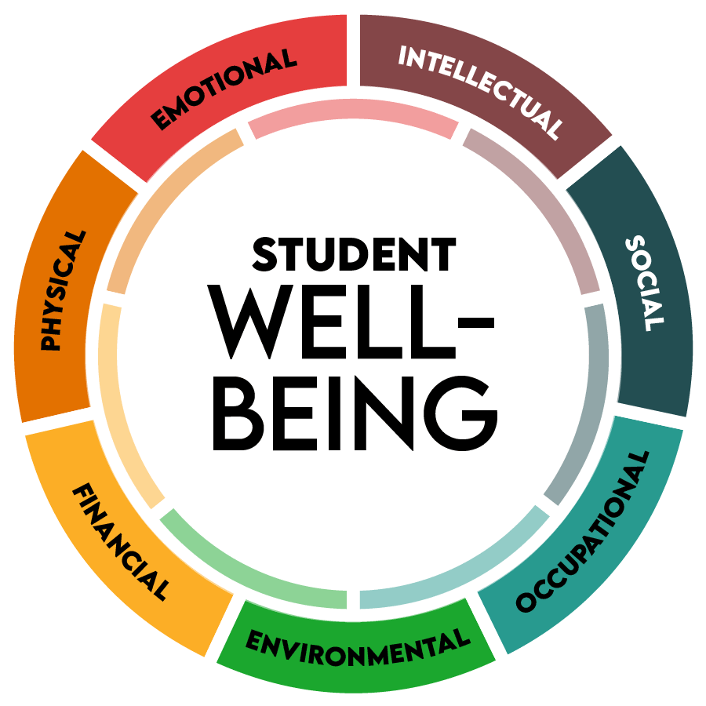

But how do we IMPROVE these things?

Slide 4
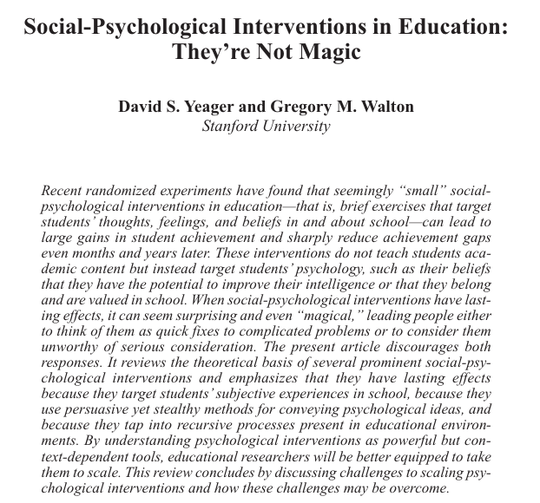
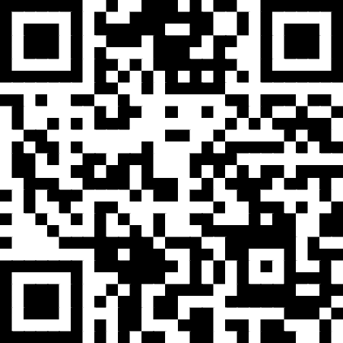
We can absolutely build interventions that improve “noncognitive” skills, as long as they’re…
Theoretically sound
Engaging
Hidden
Writing is a primary mechanism for engagement, meta-cognition
Yeager, D. S., & Walton, G. M. (2011). Social-psychological interventions in education: They’re not magic. Review of educational Research, 81(2), 267-301.

Slide 5

Academic Affairs is Easy
LO1
Intervention
Assessment
LO2
Intervention
Assessment
Academic Learning
Student Development

Slide 6
Assessment, not TESTING
What most of us do is TESTING….
ASSESSMENT is a process and a term that comes from psychiatry. It’s not just about gathering data, it’s about having a moment to speak with someone about your results and determine a course of action.
We just started calling what we do ASSESSMENT because people don’t like TESTS.
Gather data
Discuss results
Plan action

Slide 7



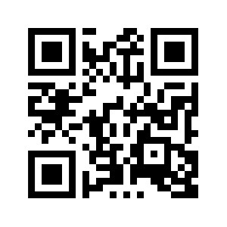
For presentation slides, other questions:
ross@diahighered.com

Slide 8
Reflection and ISSAQ
(AKA how we do reflection)

Slide 9
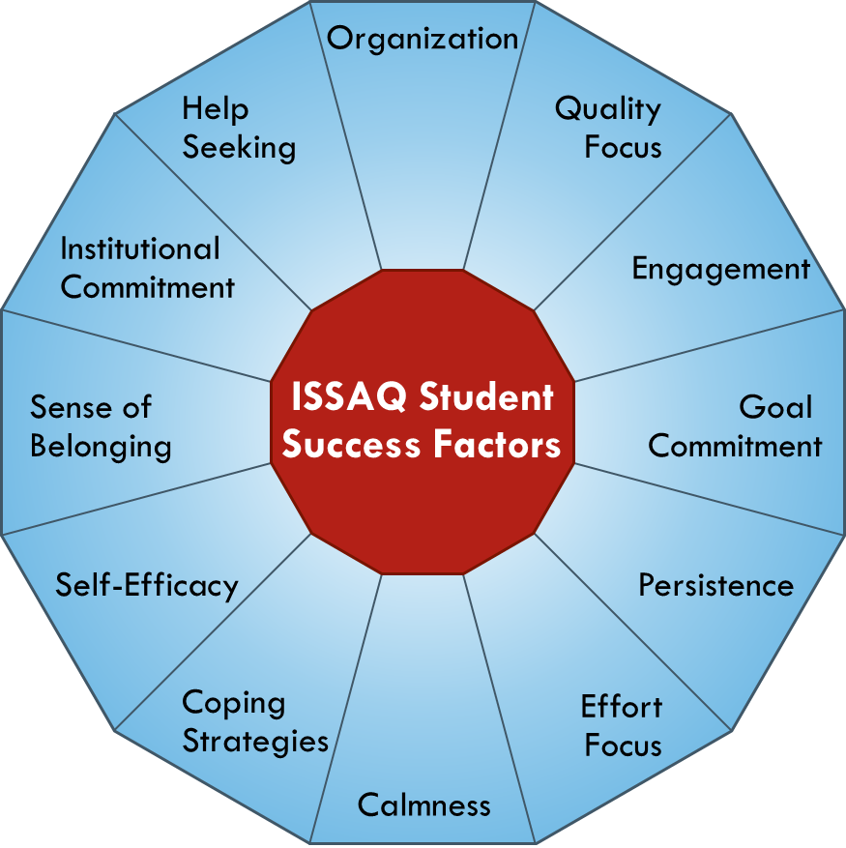

The ISSAQ Student Survey (ISSAQ-SS)
The ISSAQ-SS is a broad-based measure of 12 noncognitive (behavioral, motivational, emotional, and social) factors that have been shown to relate to student success in college.
ISSAQ-SS Fast Facts:
  Web-based survey platform compatible with computers, tablets, and smart phones
  ~100 items (80% of students complete the survey in 20 minutes or less)
  Includes bonus career efficacy, financial worry, and basic needs items (not scored)
Notes:
Amid many definitions, we describe noncognitive skills as the behavioral, motivational, emotional, and social components of student success.
In other words, noncognitive factors are to student success as learning outcomes are to academic affairs: they are the skills, strategies, and mindsets we know students “need” in order to learn, develop, and succeed.
When we view student success through the lens of noncognitive skills, it becomes clear that improving student success is not about more resources, its about the effective deployment of the resources we have – getting them to the right students at the right time.
When is the right time? Why the first-year, of course
Who are the right students?
93 noncog
16 other

Slide 10
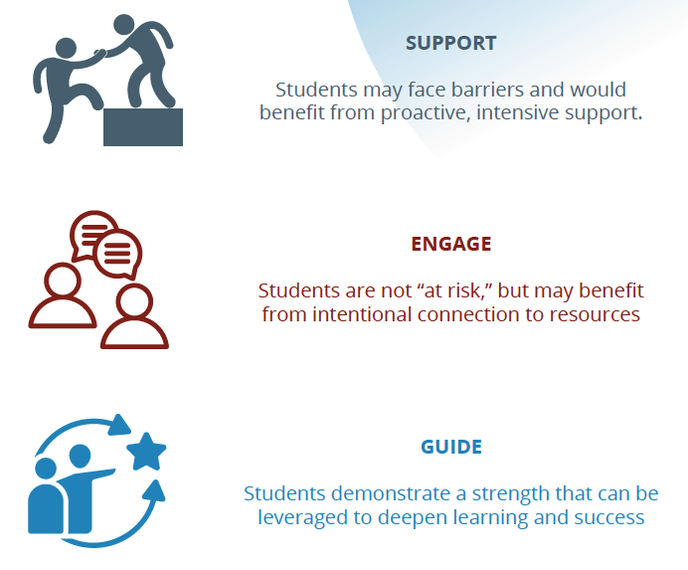

Slide 11
ISSAQ Reflection Process
ISSAQ-SS
~15 minutes
In-class or assignment
Receive report
Receive directly or in-class
GROWTH MINDSET
Discuss results
In-class
w/advisor?
Students complete survey
Reflection
Agreement
Strengths/opportunities
Plan of action

Slide 12
Timeline
Module 2:
ISSAQ results debrief
Reflection, planning activity
End of module survey
Prior to this year, repeated data showing low Sense of Belonging >>> Faculty dev
Module 1:
Importance of noncog skills
ISSAQ Overview
ISSAQ completion
Instructor Survey
Faculty Development
Sep. 2024
Dec. 2024
Integrated general UNIV 1100 instructor training w/ focus on Sense of Belonging, use of ISSAQ results

Slide 13

Free resources (ross@diahighered.com)
Action planning activity
Curriculum/ Facilitator Guides
Reflection activity
W4SS
(writing prompts)

Slide 14
Reflection
What resonates?
What doesn’t?
Strengths? + meaning
Challenges? + meaning
Action Planning
Think back
Do overs
Double downs
New strategies + resources

Slide 15
One institution’s Results

Slide 16
Students | Perceptions of ISSAQ Score Report
Comprehension of Results
I understand the results in my ISSAQ Score Report.
Perceived Report Accuracy
I agree with the strengths/challenges identified in my ISSAQ Score Report.

Slide 17
Students | Overall ISSAQ Survey Perceptions
Endorsement of ISSAQ Survey
I would recommend other students complete ISSAQ to learn about their noncognitive strengths & challenges.

Slide 18
Students | Use of Strengths
Perceived Ability
I feel confident in my ability to maximize these strengths to enhance my success in college.
Need for Support
I would like additional guidance/support on how to maximize these strengths.

Slide 19
Students | Perceptions of ISSAQ Module
Utility of Module Components
Please indicate the extent to which you found the following ISSAQ Module components useful/informative:

Slide 20
Students | Perceptions of ISSAQ Module, Cont.
Perceived Module Outcomes
After completing the ISSAQ Module…
I understand the 12 ISSAQ factors and how they relate to success in college.
I know more about my personal strengths/challenges and how they can impact my success in college.
I feel motivated to address my noncognitive challenges/maximize my strengths.
I feel equipped to address my noncognitive challenges/maximize my strengths.

Slide 21
Students | Qualitative Module FEEDBACK
Positive Feedback
What did you like most about the ISSAQ Module? (n=397)
In total, 83% of survey respondents provided positive feedback about the ISSAQ module. Overwhelmingly, their feedback mentioned the following:
Opportunity for Self-Reflection & Growth
  “The ISSAQ module allowed for a lot of self-reflection.”
  “That it gave me time to reflect.”
  “I like learning about areas I need to improve in. Improving in these areas will help me become a better student and be successful in college.”
  “It informed me a lot about myself and has actively helped me with my challenges.”
  ”I [found out] things about myself that can help me in the future.”
  “Giving me the strength to sit down and address some of these things.
  “That it humbled me about things I wouldn't have addressed.”
The ISSAQ Student Survey & Score Report
  “I enjoyed the score report the most. It allowed me to view some of my strengths and weaknesses in detail.”
  “How my results actually applied to me.”
  “The very deep questions it asked that truly made me think about how I work, study, and comprehend material.”
  How quick and accurate [the survey] is.
  “How it accurately highlighted my strengths and challenges, and gave more info on how to build on them both.“
  “How after the scores came back ISSAQ gave websites/apps or strategies to help with each category.”
  “I liked that it didn’t discourage me about the things that I need to work on.”

Slide 22
Students | Qualitative Module FEEDBACK
Positive Feedback
What did you like most about the ISSAQ Module? (n=397)
Additionally, the following themes were identified:
Learning about ISSAQ Factors
  “I liked the factors that were provided and how each one described something very important for college success.”
  “The 12 different factors and how they can help you succeed in college.”
  “How it helped me realize some of the key factors for success in college.”
  “Learning about the success factors.”
Other Module Components
  “I like the reflection assignment, it really made me think about my score and what I need to work more on.”
  “The class discussion we had about the different factors.”
  “Listening to my peers and finding out that they are having similar experiences as me.”
  “I liked how you were able to discuss your results on the module instead of just doing the survey and submitting it.”
  “Building a plan for success.”
  “Getting to reflect and make a plan moving forward.”
  “…the steps and critical thinking included in the questions and after activities.”
  “I liked the detailed in class lecture my instructor provided.”
The Personalized Experience
  “I liked that the ISSAQ module was catered differently to every student.”
  “I liked how everything was very personal, and I was mainly in control [of my learning experience].”
  “I like how its personal to everyone and tries to help us be our best academic selves.”

Slide 23
What are these results telling us?
  “I liked that it didn’t discourage me about the things that I need to work on.”
  “Listening to my peers and finding out that they are having similar experiences as me.”
I know more about my personal strengths/challenges and how they can impact my success in college.
  “I like how its personal to everyone and tries to help us be our best academic selves.”
Learning (ish)
Self-efficacy
Growth mindset
Growth mindset

Slide 24
What’s next?

Slide 25
Where Can you connect this work?
Creating a reflection section/activity in your own FYE course
Consider doing this based on an assessment that’s meaningful for your institution
Integrating reflection activities into advising
Integrating success-based writing activities into gateway writing courses

Slide 26
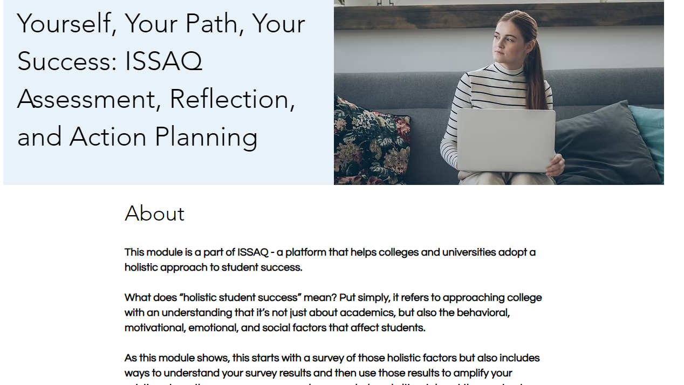

Slide 27
Multi-level Evaluation of a faculty development initiative
Kirkpatrick (1979, 1994)
Behavior
Learning
Reactions
The Program
Results
Level | Definition | Faculty Training Example
Reactions | Self-report evaluations of the program | Immediate post-training surveys
Learning | Assessing the acquisition of knowledge or skill | Measures of knowledge, skill, attitude change
Behavior | Implementation of the knowledge/skill | Post-training (e.g., end of term) surveys to evaluate strategy use
Results | The ultimate, target outcome of the training | Comparing academic success/retention for participants and non-participants

Slide 28
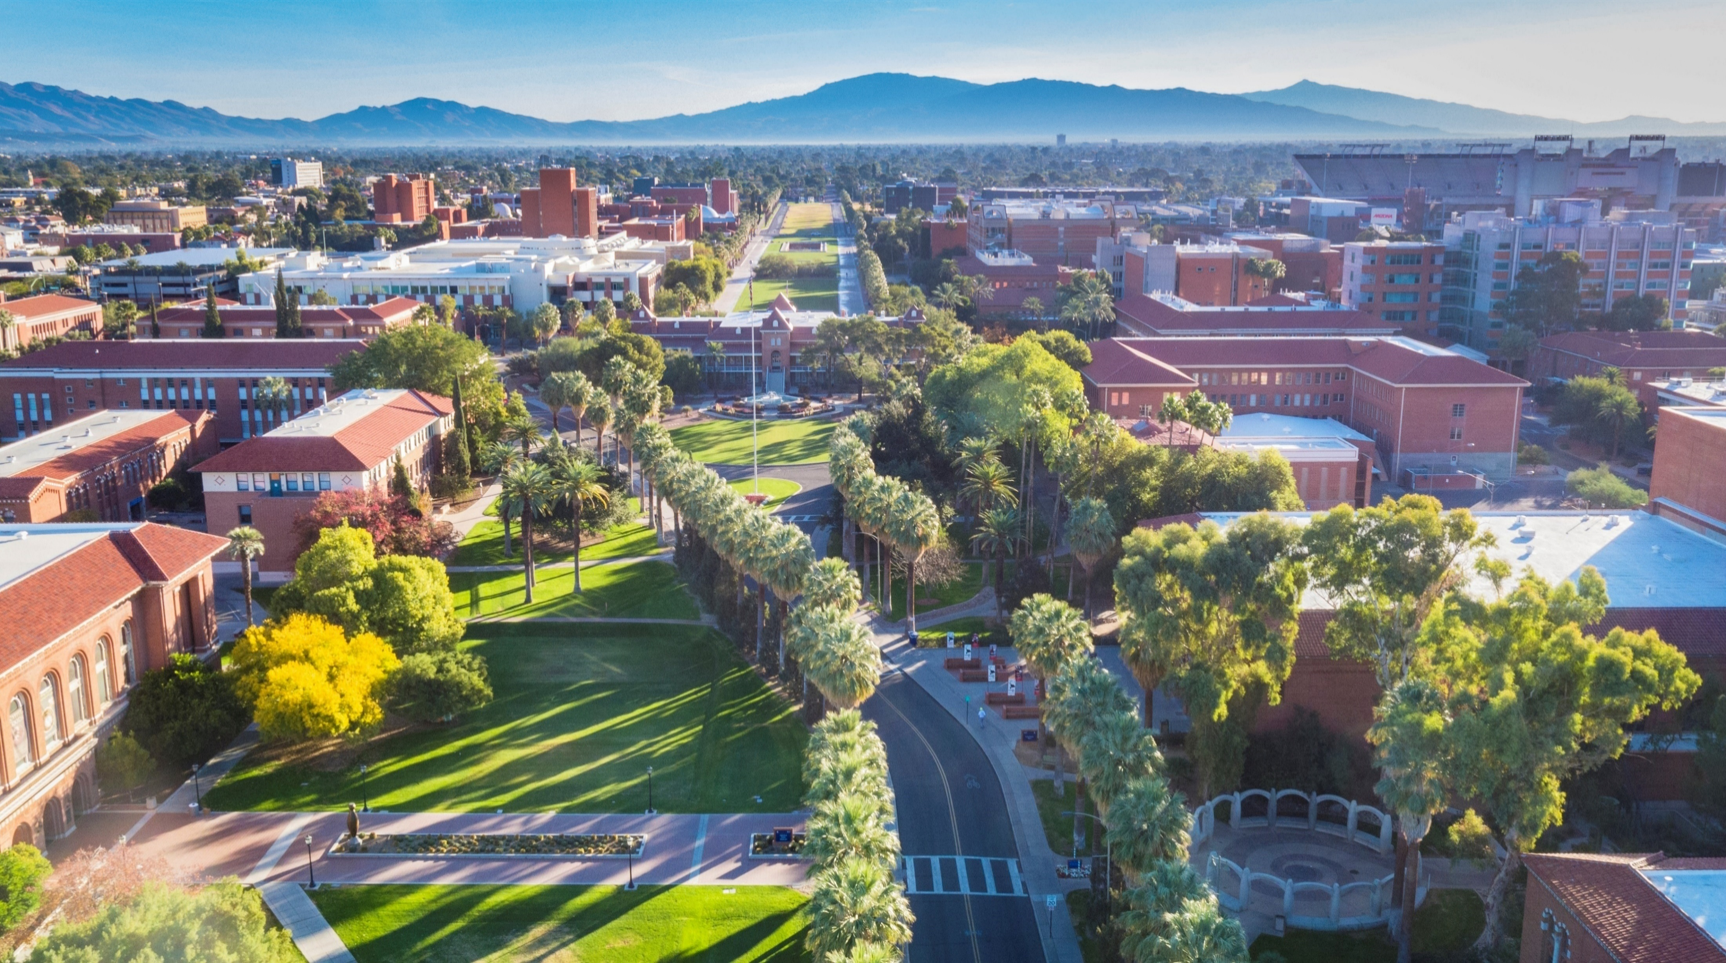


“From the top down”
Individual student interactions
Building programs to serve students at-scale
Redesigning systems of holistic understanding and support
“From the bottom up”

Slide 29









For presentation slides, other questions:
ross@diahighered.com
PARTNERS WANTED
Your logo here!
www.issaq.net
info@issaq.net
Gather data on key student strengths and challenges
Connect students with interventions within & outside of your institution
Holistic advising, coaching, counseling
Involve faculty in student success

