Slide 1
ISSAQ Assessment

Slide 2
Agenda
Time | Item | Resources
10 mins | What are noncognitive skills? | PPT
5 mins | Overview of the ISSAQ-SS | PPT
20 mins | Take the ISSAQ-SS | Resonant link
15 mins | Discussion | DQ’s in PPT
Assignment | ISSAQ-SS Reflection Exercise | ISSAQ-SS Reflection Exercise
Other topics…
How does the class connect to this?
What other campus resources connect?
Which class period? (week of 9/12)

Slide 3
What do you think you need most to be successful in college?
Notes:
Students often think you need to be smart, high IQ, be well prepared, etc. They often overlook the importance and value of noncognitive skills.

Slide 4
Organization
Help
Seeking
Quality
Focus
Institutional
Commitment
Engagement
ISSAQ Student Success Factors
Sense of
Belonging
Goal
Commitment
Self-Efficacy
Persistence
Coping
Strategies
Effort
Focus
Calmness

Slide 5
What are noncognitive skills?
ISSAQ Student Survey factors.
Factor | Description
Organization | The behaviors and strategies that a student uses to organize their work and time.
Quality Focus | A student’s emphasis on high-quality work and avoidance of errors.
Engagement | The increased expectations of college-level courses with regards to attendance, assignment completion, and involvement.
Goal Commitment | A student's value and prioritization of a college degree goal.
Persistence | The maintenance of effort in the face of challenges.
Effort Focus | The perception that success is rooted in effort, rather than innate ability.
Calmness | Resistance to stress.
Coping Strategies | The use of adaptive and/or problematic coping strategies when dealing with stress.
Self-Efficacy | An individual’s belief that they will be successful in college.
Sense of Belonging | A feeling of connection to the people within a college or university.
Institutional Commitment | A student’s attitude toward the college or university as a whole.
Help Seeking | A student's attitudes toward asking assistance when problems arise.
The behavioral, motivational, emotional, and social domains of student success
Notes:
Review how each of these factors are defined.

Slide 6
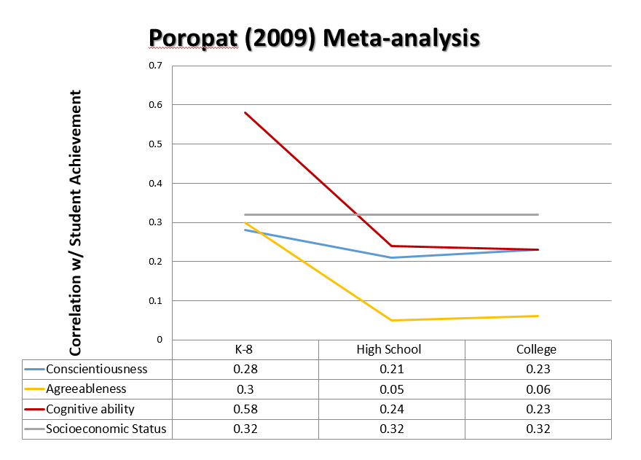
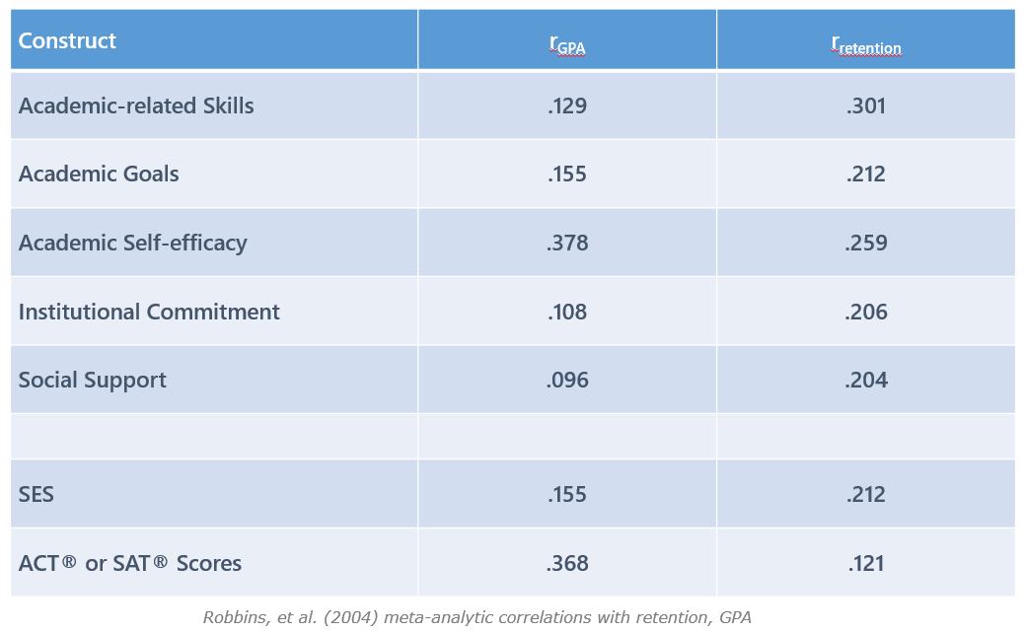
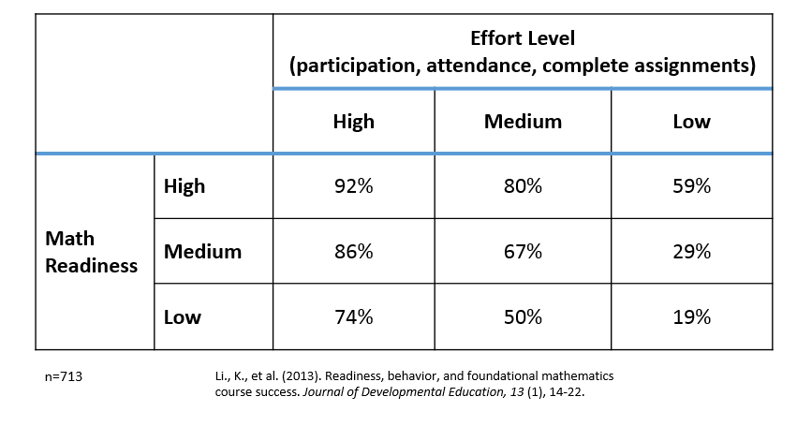
Research Into Noncognitive Skills and Success
Noted importance in both educational and workforce sectors
Oswald et al., 2005; Casner-Lotto & Benner, 2006
Significant predictive validity
Robbins et al, 2004; Poropat, 2009; Richardson, Abraham, and & Bond, 2012
Even when controlling for previous academic achievement
Equal or stronger predictor of persistence than pervious academic achievement (Robbins et al., 2004; Markle et al., 2013)
Advantages when working with traditionally underserved populations
Li et al., 2013; Tracey & Sedlacek, 1986; Dennis, Phinney, Chateco, 2005; Ting, 2003
Notes:
Show them the data, especially the next slide…

Slide 7
Notes:
Take time to breakdown and explain this slide. This can be eye opening for students. High effort level and low readiness leads to higher success rate than high readiness and low effort. Effort matters!

Slide 8
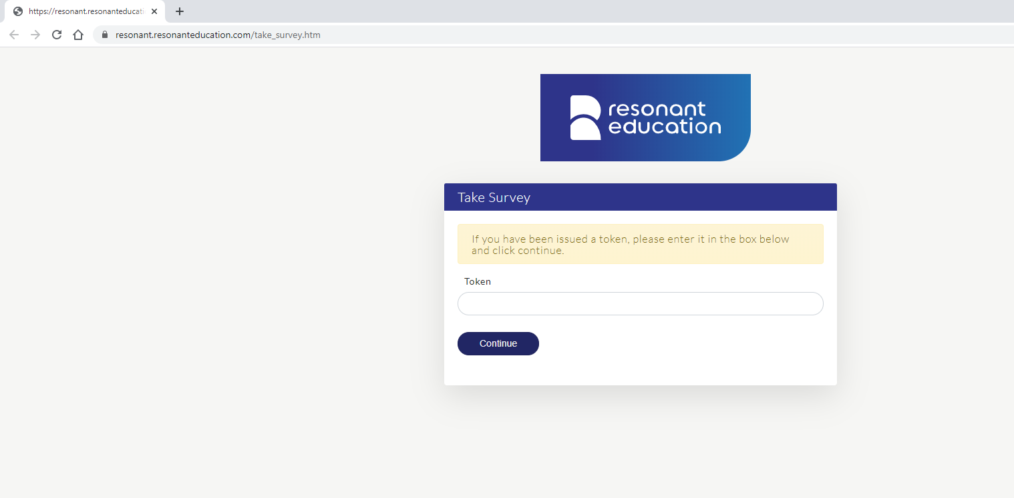
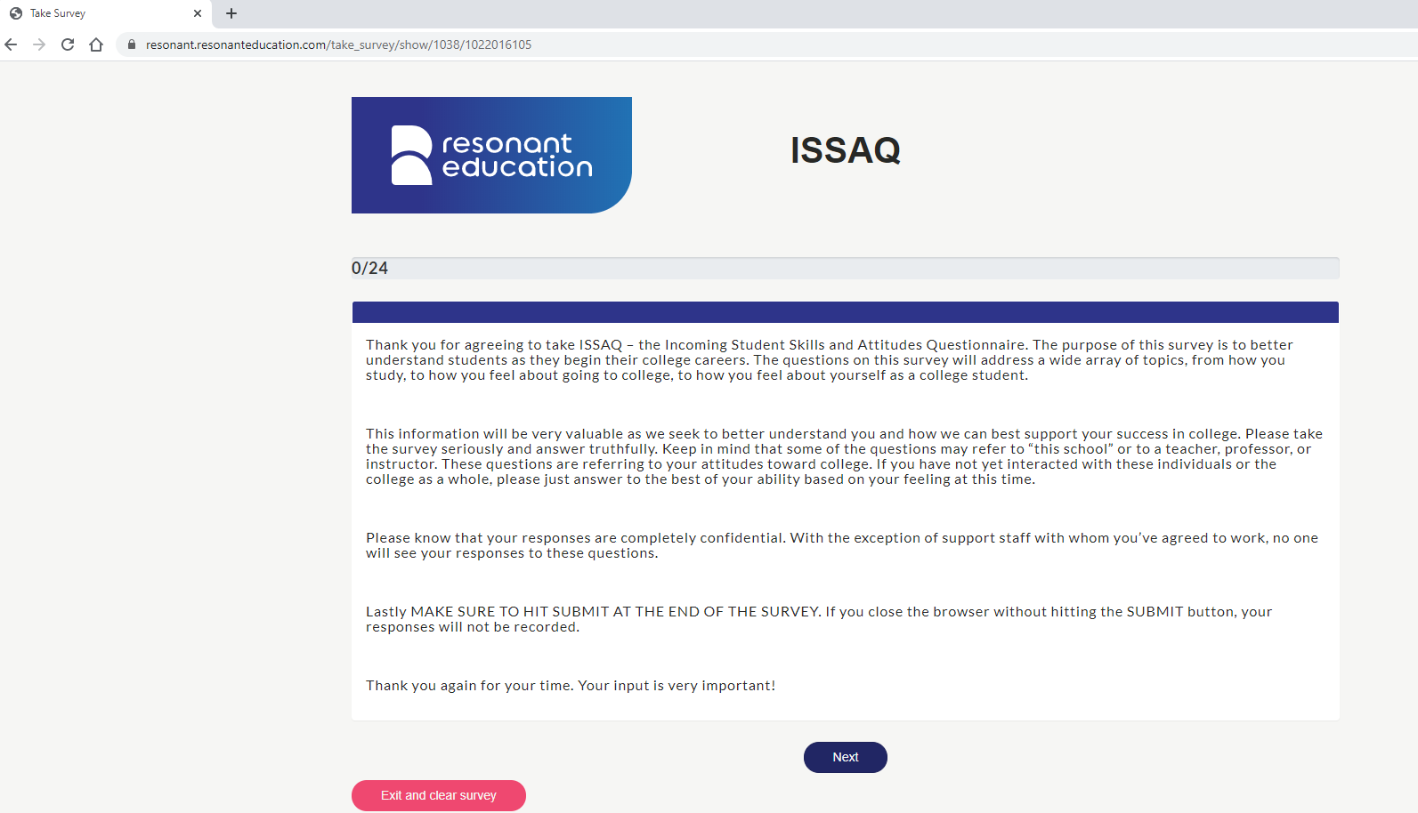
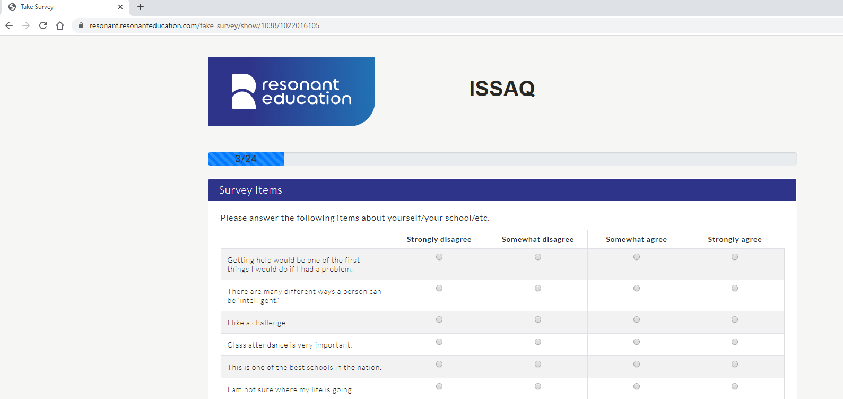
The ISSAQ Student Survey
Connect students with online survey
Open link
Uploaded roster
Students then receive instructions about the purpose, importance, and confidentiality of the assessment.
Students then complete brief, Likert-type statements about their behavioral, motivational, emotional, and social attributes.

Slide 9
Key points about the survey
Importance
There are no “right” answers
Your first answer is usually the best one
Confidentiality
Expectation (experience, time, etc.)

Slide 10
ISSAQ Instructions
Thank you for agreeing to take ISSAQ – the Incoming Student Skills and Attitudes Questionnaire. The purpose of this survey is to better understand students as they begin their college careers. The questions on this survey will address a wide array of topics, from how you study, to how you feel about going to college, to how you feel about yourself as a college student.
This information will be very valuable as we seek to better understand you and how we can best support your success in college. Please take the survey seriously and answer truthfully. Keep in mind that some of the questions may refer to “this school” or to a teacher, professor, or instructor. These questions are referring to your attitudes toward college. If you have not yet interacted with these individuals or the college as a whole, please just answer to the best of your ability based on your feeling at this time.
Please know that your responses are completely confidential. With the exception of support staff with whom you’ve agreed to work, no one will see your responses to these questions.
Lastly MAKE SURE TO HIT SUBMIT AT THE END OF THE SURVEY. If you close the browser without hitting the SUBMIT button, your responses will not be recorded.
Thank you again for your time. Your input is very important!

Slide 11
Discussion Questions
What did you think of the experience?
Were you surprised at any of the questions?

